Slide 1


Proxi Server ESP32
Esp32
ESP IoT Development Framework v5.1.3
Node.js
Visual studio code

Slide 2
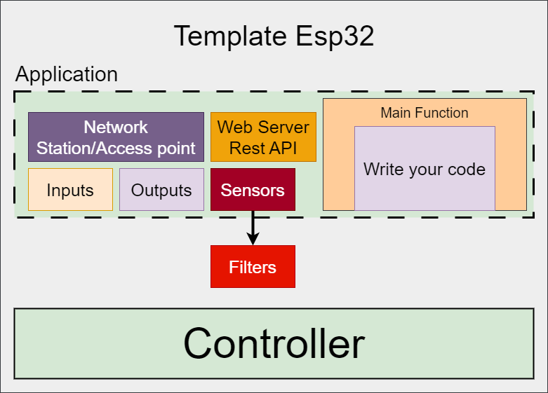
IoT device
5
3
2
1
4
6

Slide 3
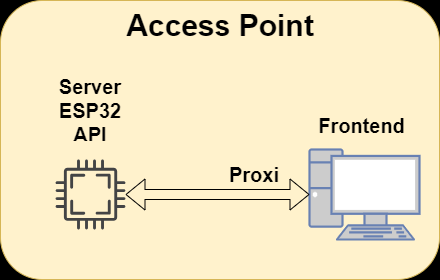
Proxi ESP32
Install Node.js
Esp32 server, REST API
npx http-server ./web -P http://192.168.4.1
npx http-server ./folder –P http://ip_esp32
Access point

